Slide 1
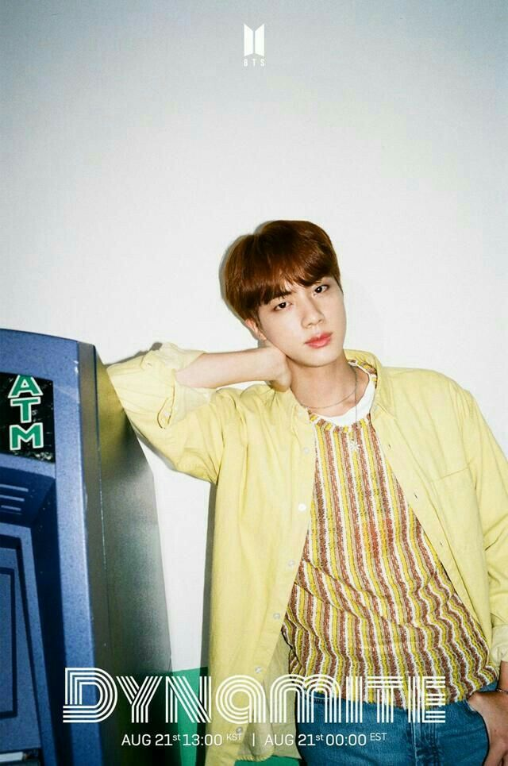
BTS & STORE

Slide 2
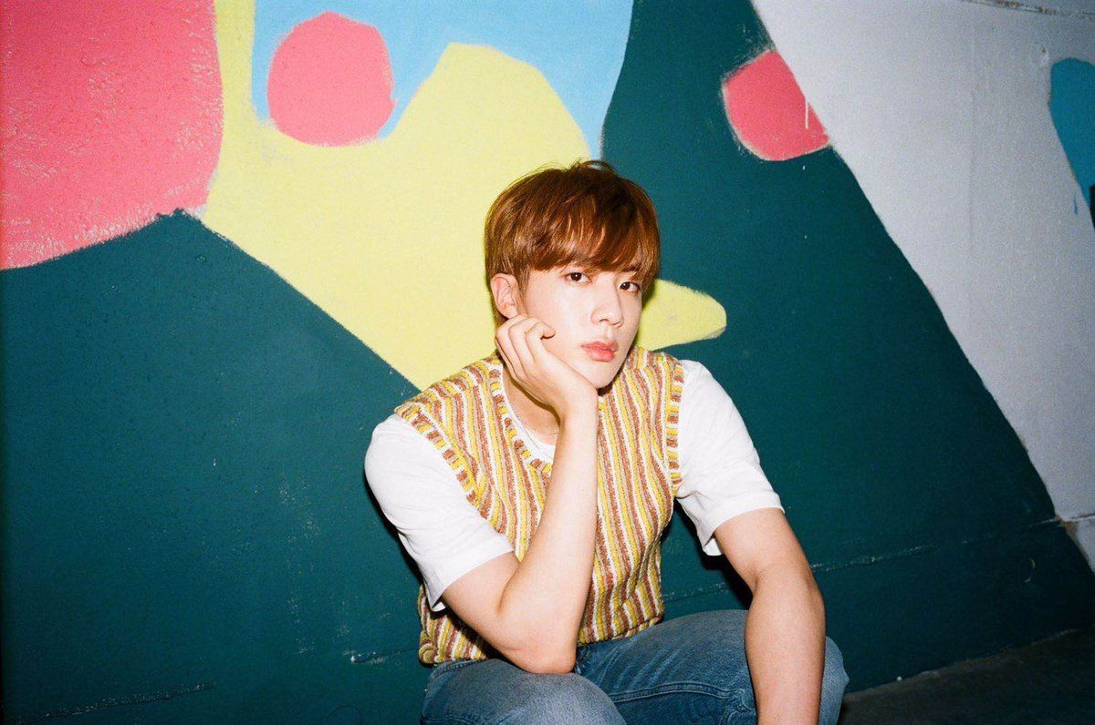
Contents
1
2
시장조사
페르소나
5
3
평가
4
기획
구현

Slide 3
1
시장조사
SLIDE SUBTITLE

Slide 4
1
Main title
SLIDE SUBTITLE

Slide 5
1
Main title
SLIDE SUBTITLE

Slide 6
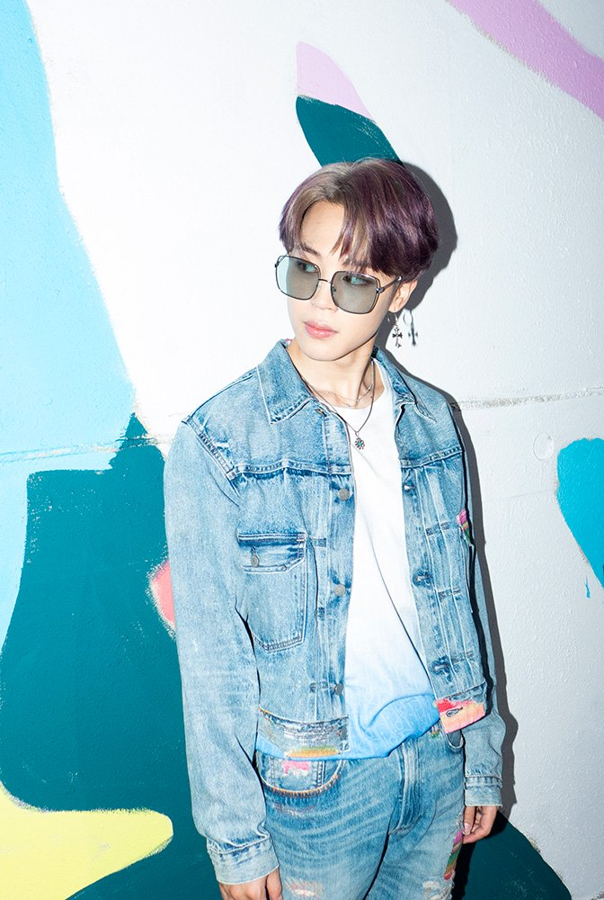
Q&A
SLIDE SUBTITLE SLIDE SUBTITLE SLIDE SUBTITLE SLIDE SUBTITLE

Slide 7
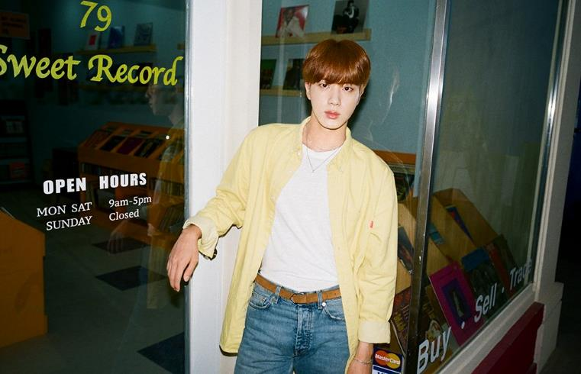
Thank you
Dynamite power point template
Copyright ⓒ 2020. eundingding All rights Reserved

Slide 8
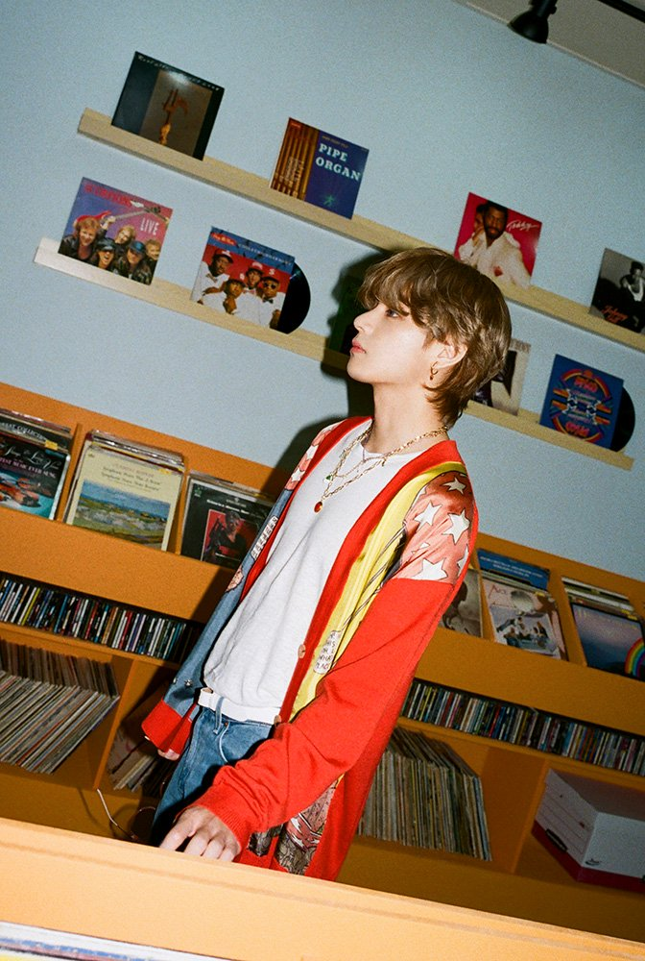
1
Main title
SLIDE SUBTITLE SLIDE SUBTITLE SLIDE SUBTITLE SLIDE SUBTITLE

